Slide 1


Balanced scorecard slide 1
GTSRB Traffic Sign Image Multi-class Classification
By Sean Sungil Kim

Slide 2
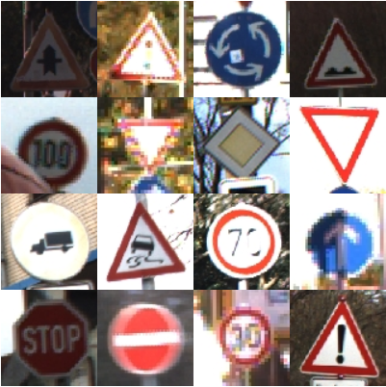
Balanced scorecard slide 2
Traffic Sign Multi-class Classification: GTSRB Data
Images vary in size, between 15x15 to 250x250.
Images are not necessarily squares.
Images are not necessarily cenetered.
Total 43 classes.
Only the training GTSRB data will be used in this project.

Slide 3
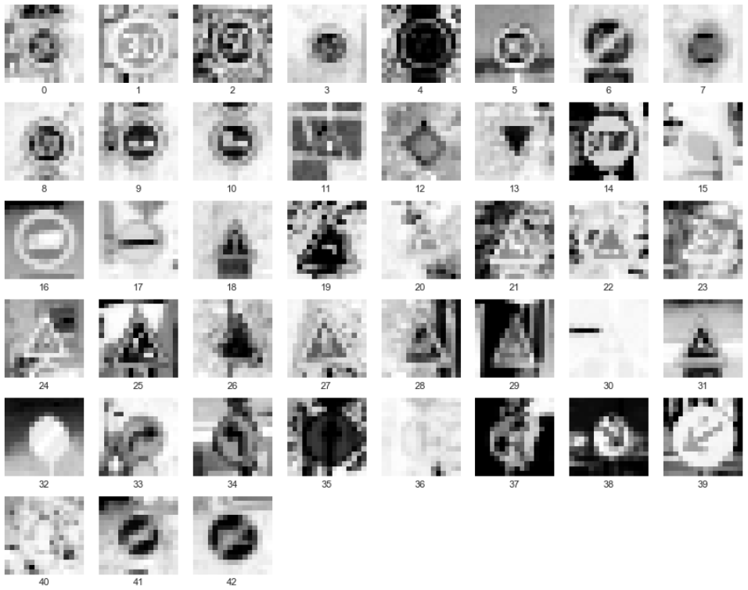
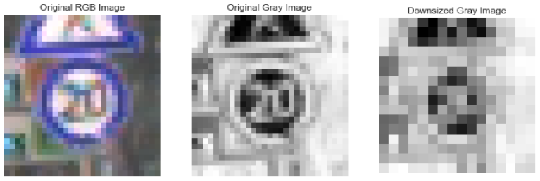
Balanced scorecard slide 2
Preprocessing: Grayscale and Downsizing

Slide 4
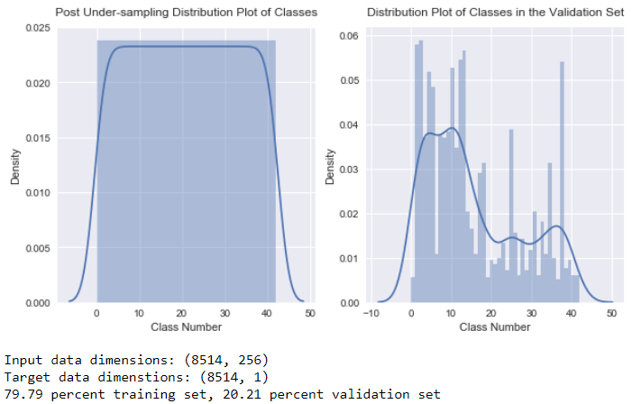
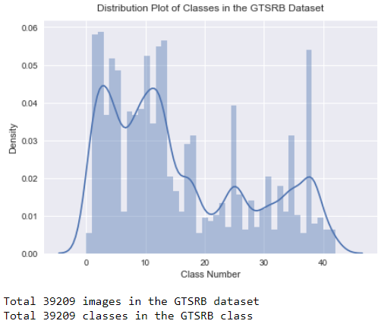
Balanced scorecard slide 2
GTSRB Class Imbalance: Random Under-sample

Slide 5
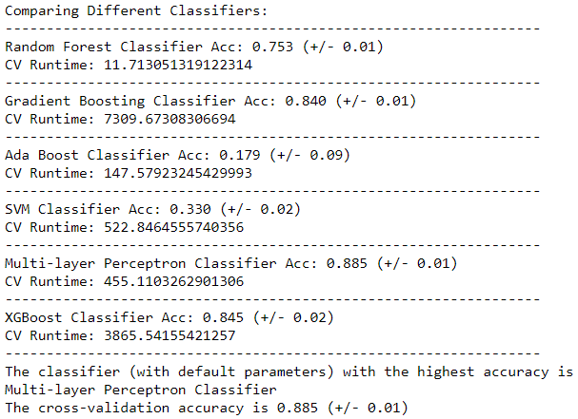
Balanced scorecard slide 2
Downsized Grayscale Image (16x16): Results

Slide 6
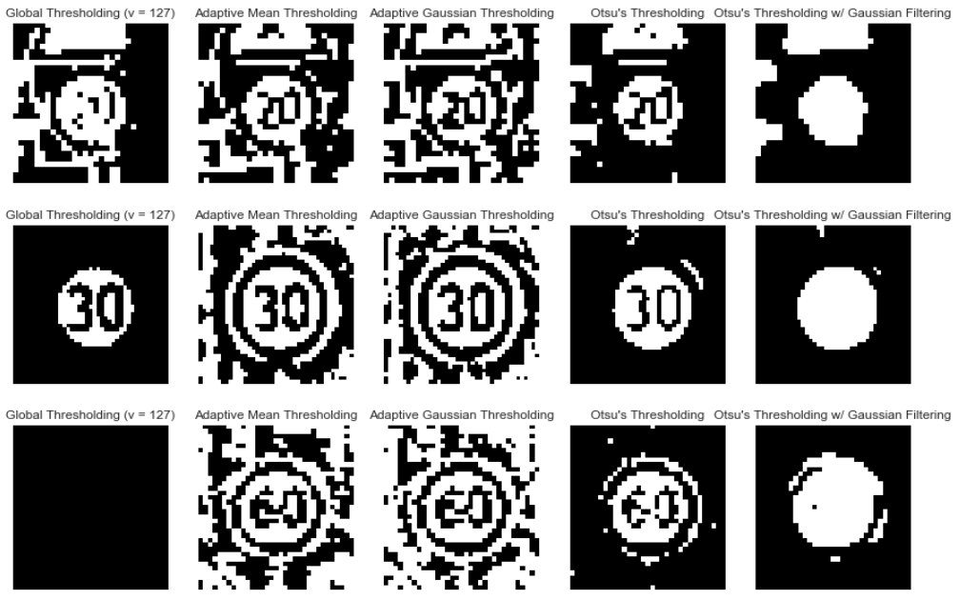
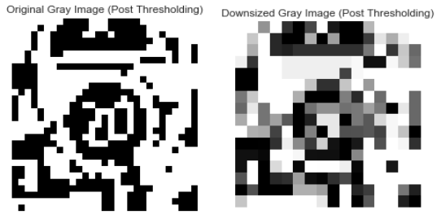
Balanced scorecard slide 2
Feature Extraction: Thresholding

Slide 7
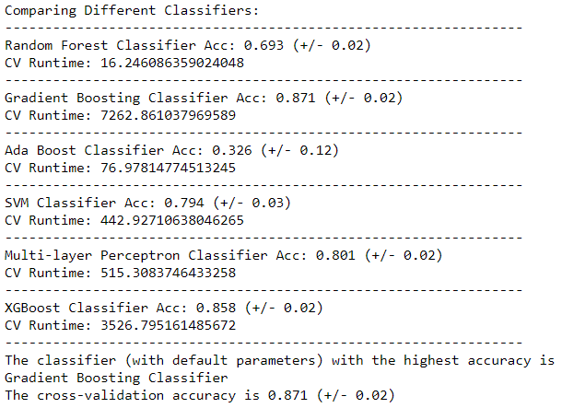
Balanced scorecard slide 2
Feature Extraction: Thresholding Results

Slide 8

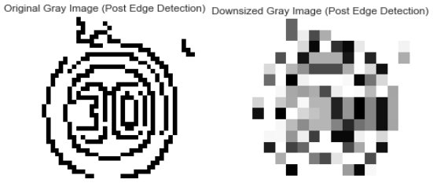

Balanced scorecard slide 2
Feature Extraction: Canny Edge Detection
downsized

Slide 9
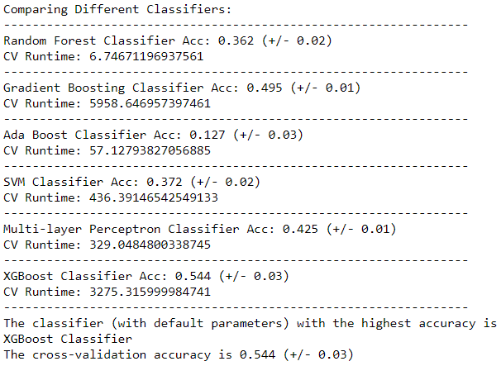
Balanced scorecard slide 2
Feature Extraction: Canny Edge Detection Results

Slide 10
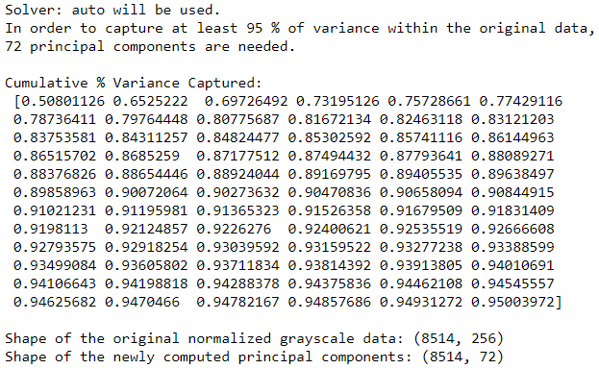
Balanced scorecard slide 2
Dimension Reduction: PCA

Slide 11
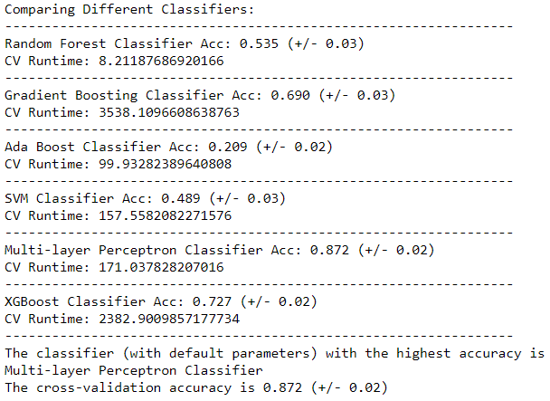
Balanced scorecard slide 2
Dimension Reduction: PCA Results

Slide 12
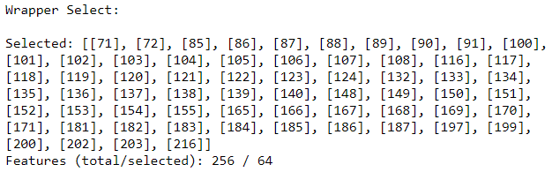
Balanced scorecard slide 2
Feature Selection: Wrapper-based (w/ RandomForest)Results

Slide 13
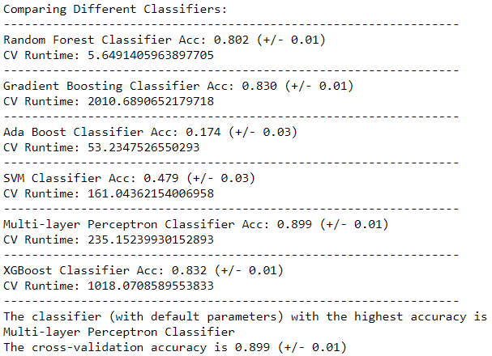
Balanced scorecard slide 2
Feature Selection: Wrapper-based (w/ RandomForest)Results

Slide 14
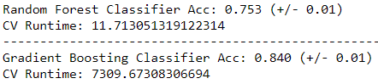
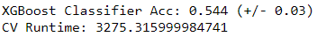
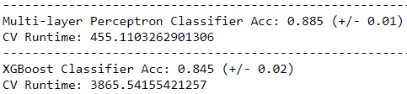
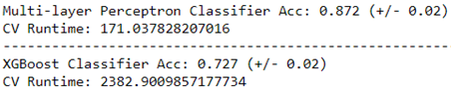
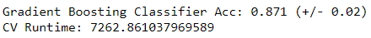
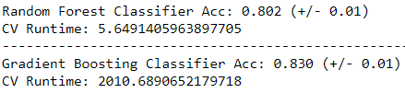
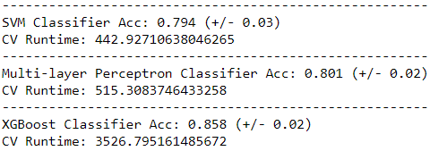
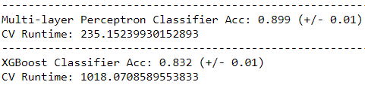
Balanced scorecard slide 2
Model Comparison and Evaluation: Runtime vs. Performance
16x16 grayscale
Canny Edge Detection
PCA
Thresholding
Feature Selection (Wrapper-based)

Slide 15
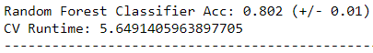
Balanced scorecard slide 2
Model Comparison and Evaluation: Runtime vs. Performance
PCA
Feature Selection (Wrapper-based)

Slide 16
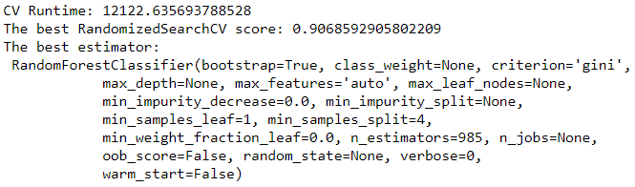
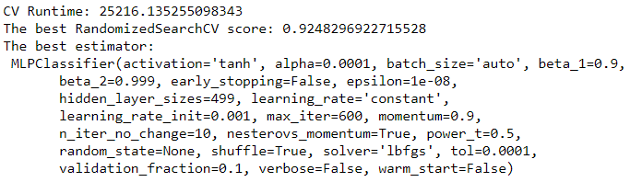
Balanced scorecard slide 2
Hypertuning Parameters: Top 2 models
Feature Selection (Wrapper-based)
RandomForest
Multi-layer Perceptron

Slide 17
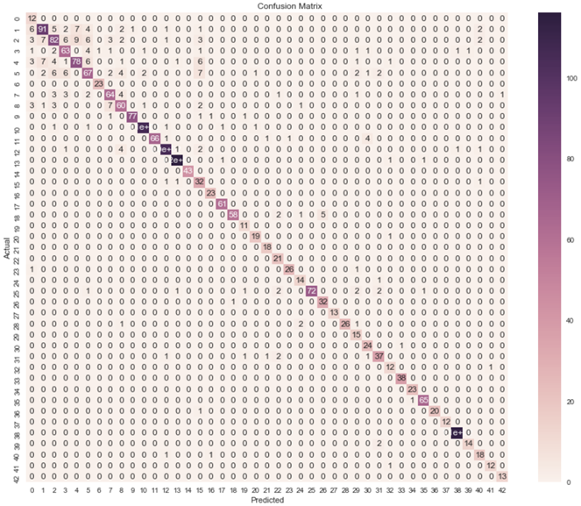
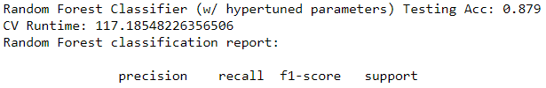
Balanced scorecard slide 2
Model Comparison and Evaluation: Final Top 2 Results
Feature Selection (Wrapper-based)

Slide 18
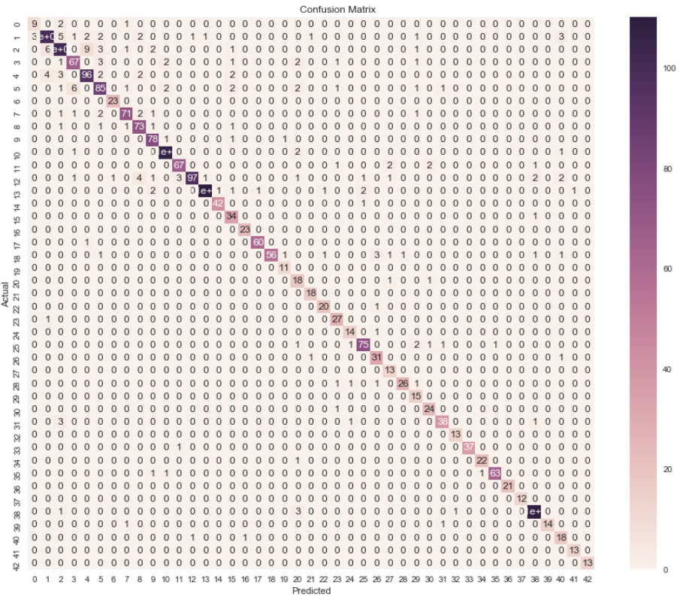
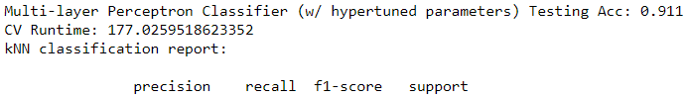
Balanced scorecard slide 2
Model Comparison and Evaluation: Final Top 2 Results
Feature Selection (Wrapper-based)

Slide 19
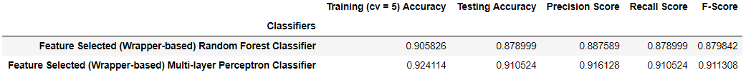
Balanced scorecard slide 2
GTSRB Traffic Sign Image Multi-class Classification: Conclusion

Slide 20
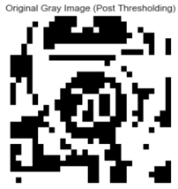

Balanced scorecard slide 2
GTSRB Traffic Sign Image Multi-class Classification: Future Work
or
+
PCA or Feature Selection = ?

